Slide 1
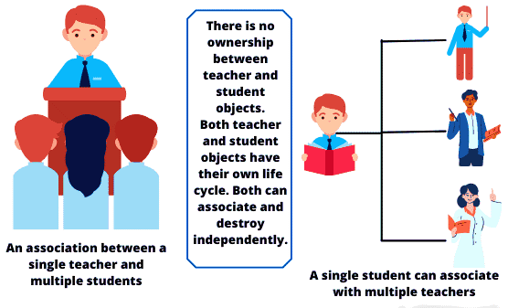
Association In Java

Slide 2
What is Association?
Association in Java is a relationship that defines the relationship between two classes that are independent of one another. It represents Has-A relationship.
Association is one of the core concepts of object-oriented programming in Java. It indicates how objects of classes communicate with each other and how they use the functionality and services provided by that communicated object.
Association establishes a multiplicity relation between objects where all objects have their own lifecycle and there is no owner of association (Has-A relationship).
A multiplicity indicates a number that specifies how many objects of the class are involved in the relationship.
Example:
Let’s take a real-time example of Teacher and Student to understand the actual meaning of association in Java programming.
Multiple students can connect with a single teacher and a single student can connect with multiple teachers but there is no ownership between objects.

Slide 3
Types of Relationships Managed by Association in Java
1. Unidirectional Association:
If an object associates with another object, it is called unidirectional association. It is also called one-way relationship.
For example, a department in college can have many students but vice versa is not possible. This is an unidirectional in nature. A tennis player has a racket. It is an unidirectional association because a racket cannot have tennis player.
2. Bidirectional Association:
When objects involved in association communicate with each other, it is called bidirectional association.
A very common example of bidirectional relationship is “Person and Address”. We can have bidirectional many-to-many relationship between person and address objects.
In other words, a person can have associated with multiple addresses and an address can belong to multiple people. This shows the many-to-many relationship.

Slide 4
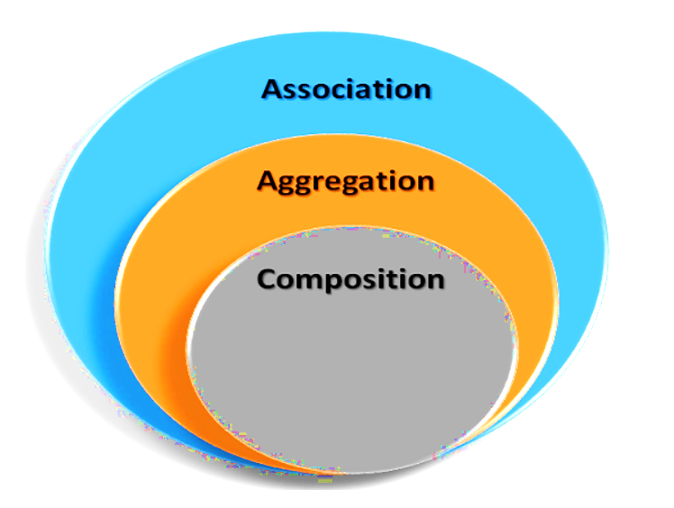
Types Of Association

Slide 5
Aggregation

